Slide 1
Zeal-Aish Cafe
Java Mini Project

Slide 2
Introduction:
The Cafe Management System is a Java application designed to streamline and simplify the process of managing a cafe's inventory and transactions. Developed using NetBeans IDE and Swing library, the system provides an intuitive user interface for customers to select food items, adjust quantities, and make purchases, while also offering administrative functions for generating receipts, resetting selections, and exiting the program.

Slide 3
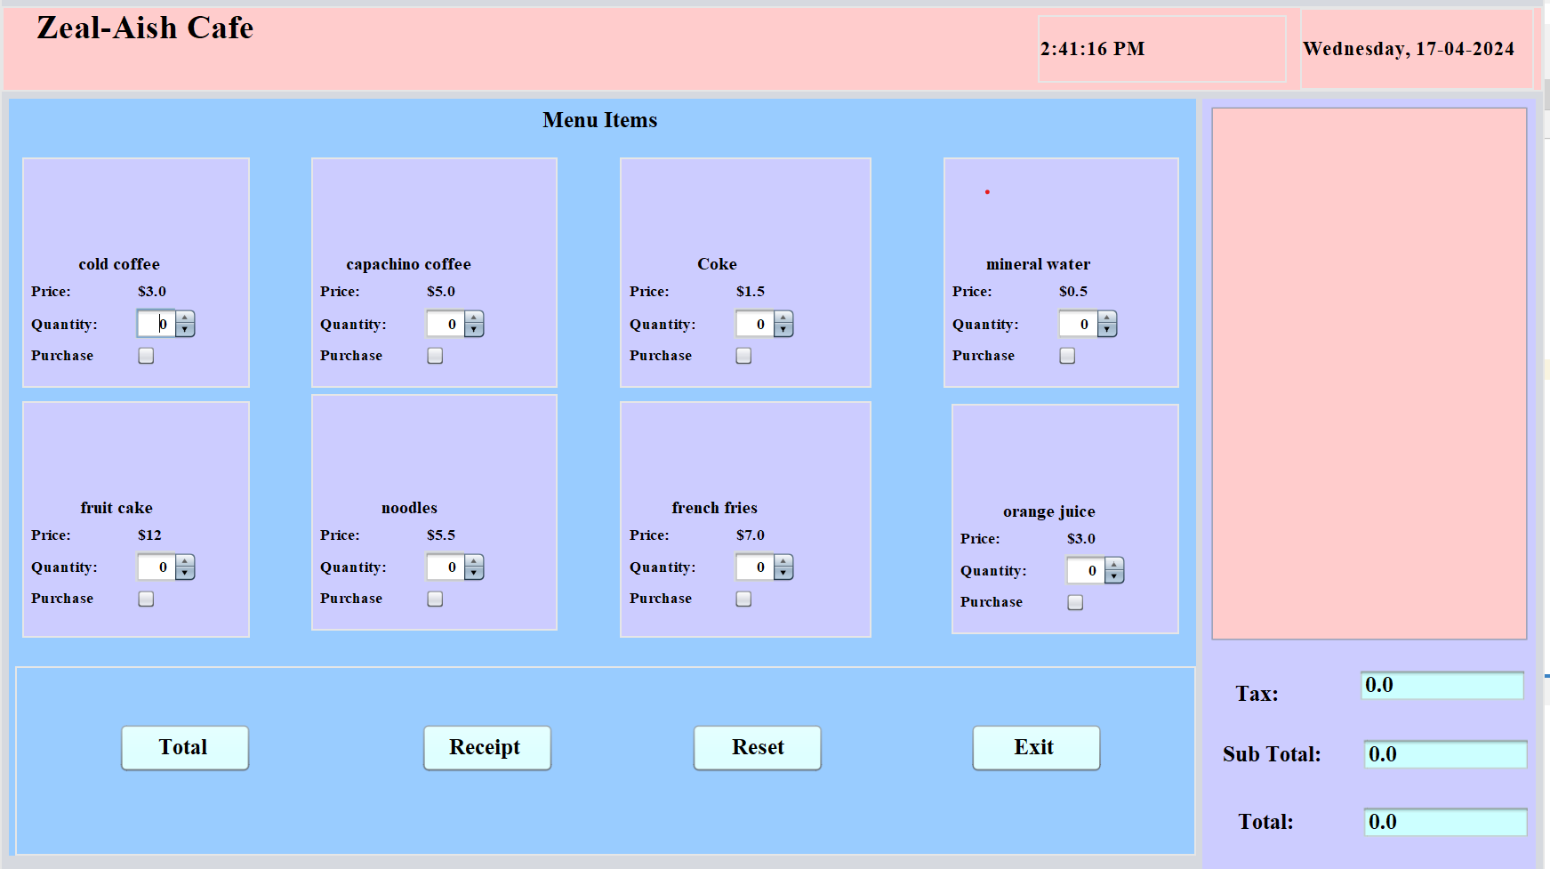

Slide 4
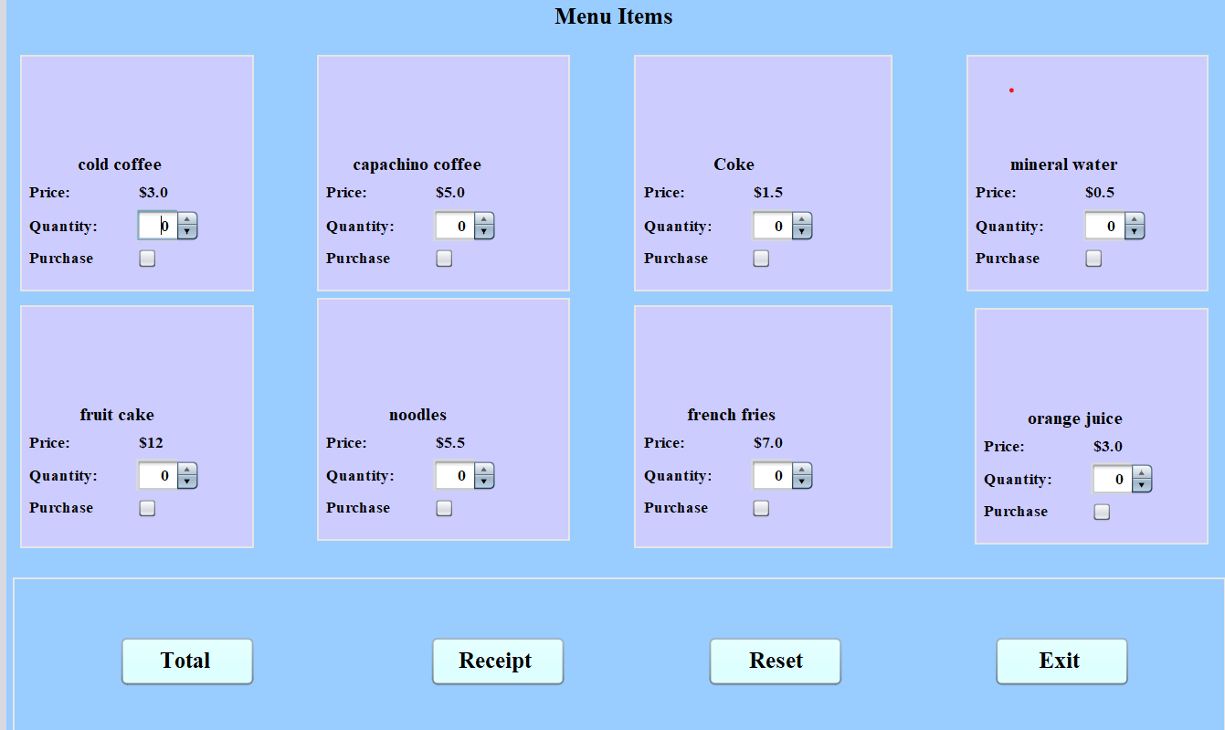
CheckBox: To Purchase to the product
Product box
Spinner: To choose the quantity of product
Buttons: to operate cae menu

Slide 5
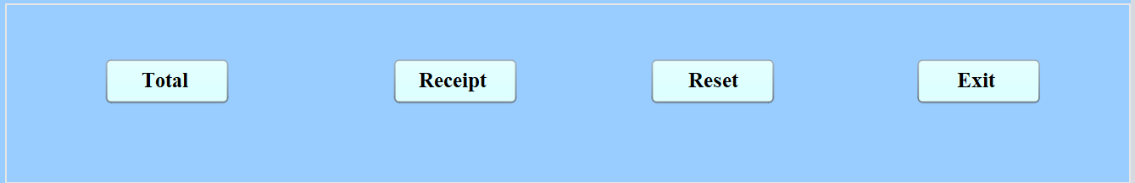
Total Button: calculates the total amount of product’s price purchased by user
Reset Button: Resets the whole menu
Receipt Button: Prints Receipt of the purchased products
Exit Button: Exists from the menu

Slide 6
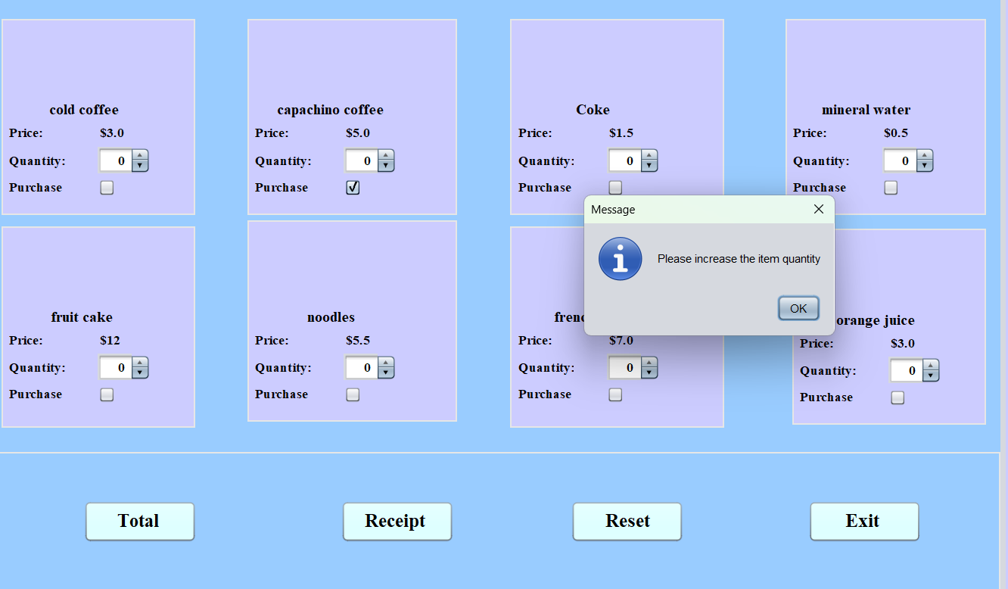
If without increasing the quantity of product an alert message will pop up saying “Please increase the item quantity”

Slide 7
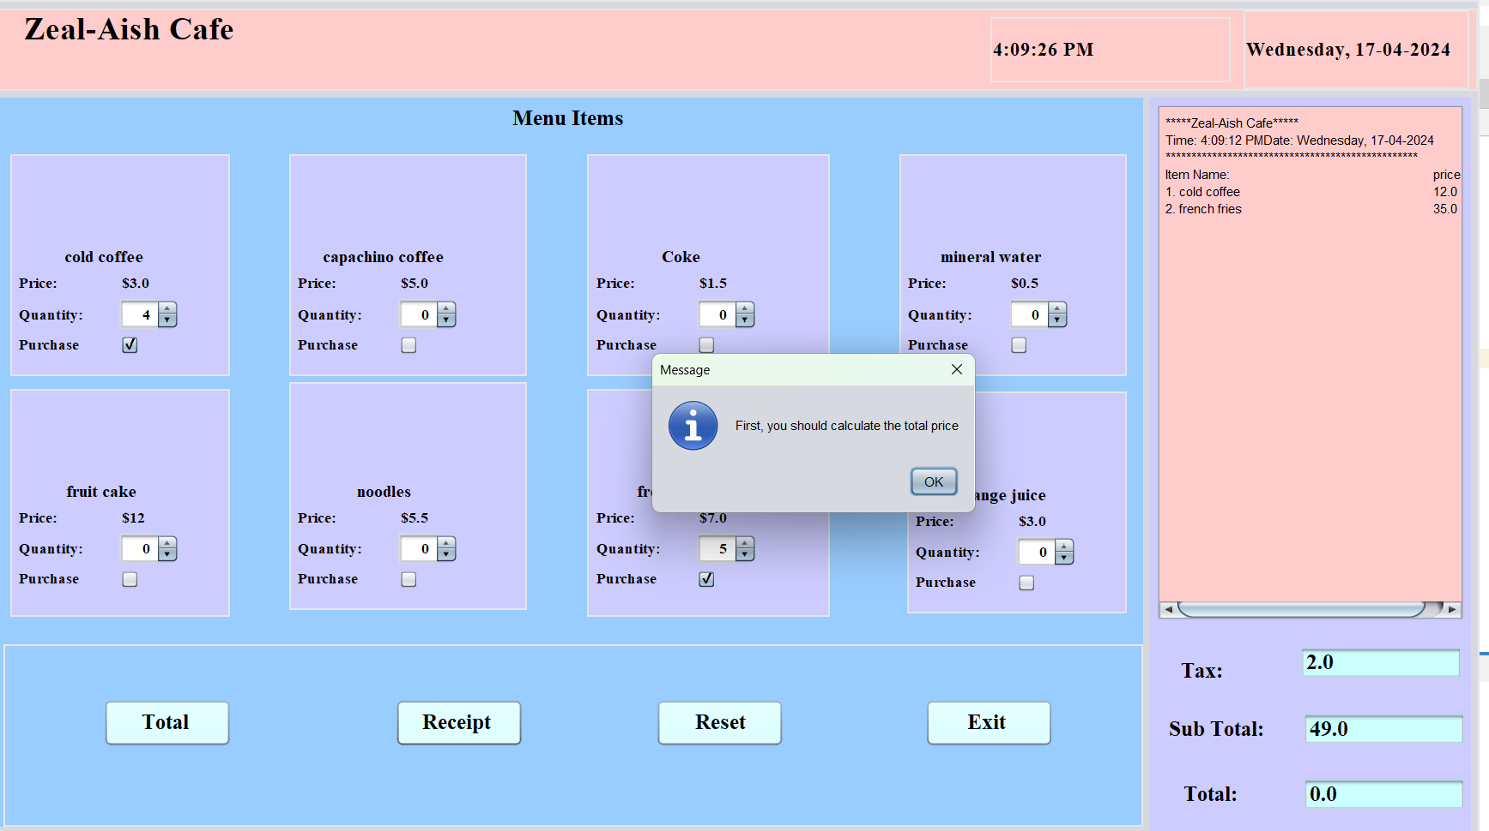
Before printing the receipt, click on Total Button to calculate total

Slide 8
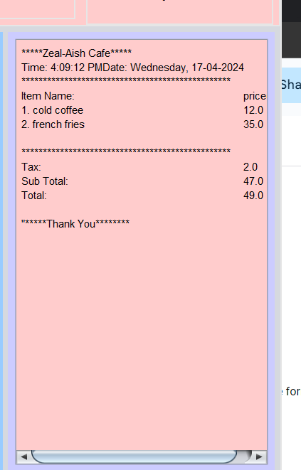
Products are added to the cart and finally a receipt is generated consisting tax, subtotal and total

Slide 9
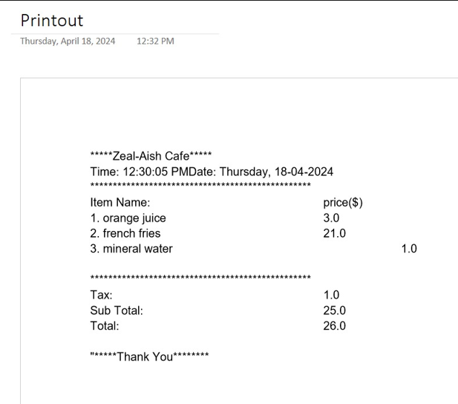
Reciept generated

Slide 10
THANKYOU

